Slide 1


“Sundaram Election Management Software”
Capstone Project for Manipal Sundaram Program
Submitted by: Gokul Hari
Submission type : Individual
Name: Gokul Hari
Batch : Manipal Sundaram Full Stack Program Batch 1
LMS Id :
Program : Sundaram Full Stack Program
Date: 22/04/2023

Slide 2

Table of contents
Introduction
Project Overview
Architecture Design
User Interface Design
Back-end Development
Front-end Development
Testing
Deployment
Conclusion
Future Work
References
Appendices

Slide 3
Introduction
An election management software is a specialized computer program designed to help election officials manage various aspects of the electoral process, such as administrator management, voter registration, candidate registration, ballot creation, vote counting, specialised user display and reporting of election results among others.
These software tools can help automate many time-consuming tasks associated with elections, improving efficiency and accuracy while reducing the potential for errors or fraud.
Some election management software also includes security features to help prevent unauthorized access or manipulation of election data, as well as tools for analysing and interpreting election results.
Overall, election management software plays a critical role in ensuring fair and transparent elections.

Slide 4
Project Overview
The objective of this project is to design and develop an election management software that can assist election officials in managing the various aspects of the electoral process. The software will be developed using modern programming languages and frameworks to ensure that it is robust, scalable, and user-friendly. The software will be an individual project that will involve designing and implementing a fully functional prototype.
The election management software will have several key features, including voter registration, ballot creation, vote counting, and reporting of election results. The software will allow election officials to create and manage voter databases, create ballots, and track votes in real-time. It will also include reporting tools that will help election officials generate reports on election results, voter turnout, and other key metrics. The software will be designed with security in mind, and will include features such as user authentication, role-based access control, and data encryption to ensure the integrity of the electoral process. The end result will be a robust, reliable, and user-friendly election management software that can be used by election officials to manage and oversee elections with ease.

Slide 5
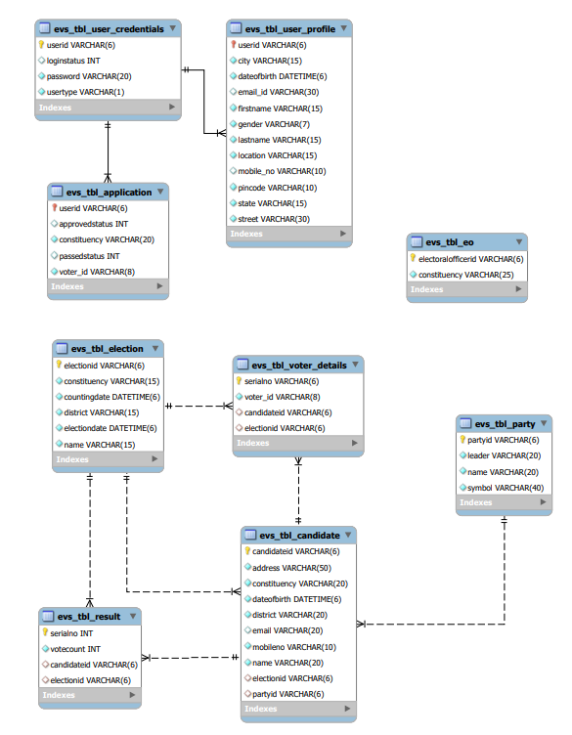
Architecture Design
The Sundaram Election Management Software is defined with compartmentalized access with authentication for each and every operation.
The database has been carefully designed to deliver results efficiently.

Slide 6
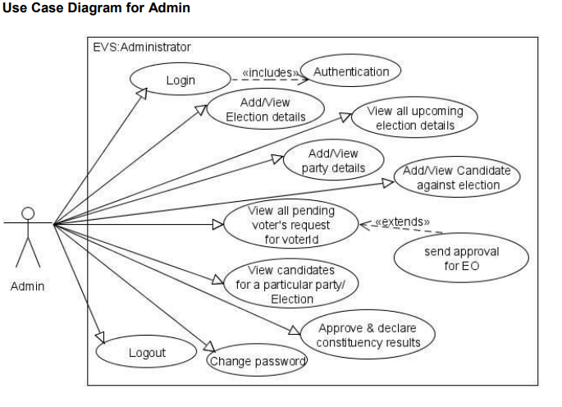
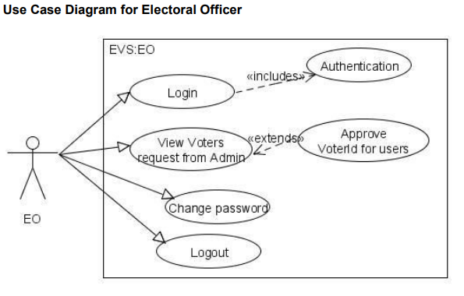
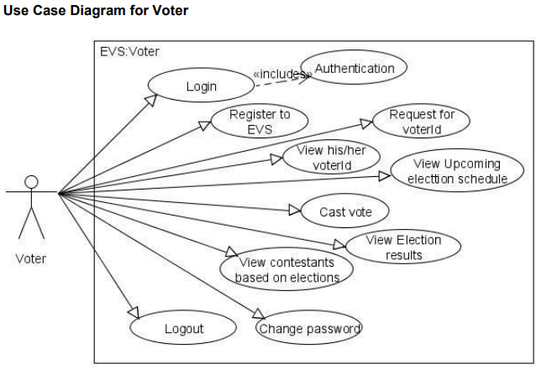
User Interface Design
The user interface design for the election management software will be intuitive, user-friendly, and visually appealing. The design will be focused on ease of use and accessibility, with clear navigation menus and intuitive controls that will enable election officials and voters to manage/use the electoral process efficiently and effectively.

Slide 7
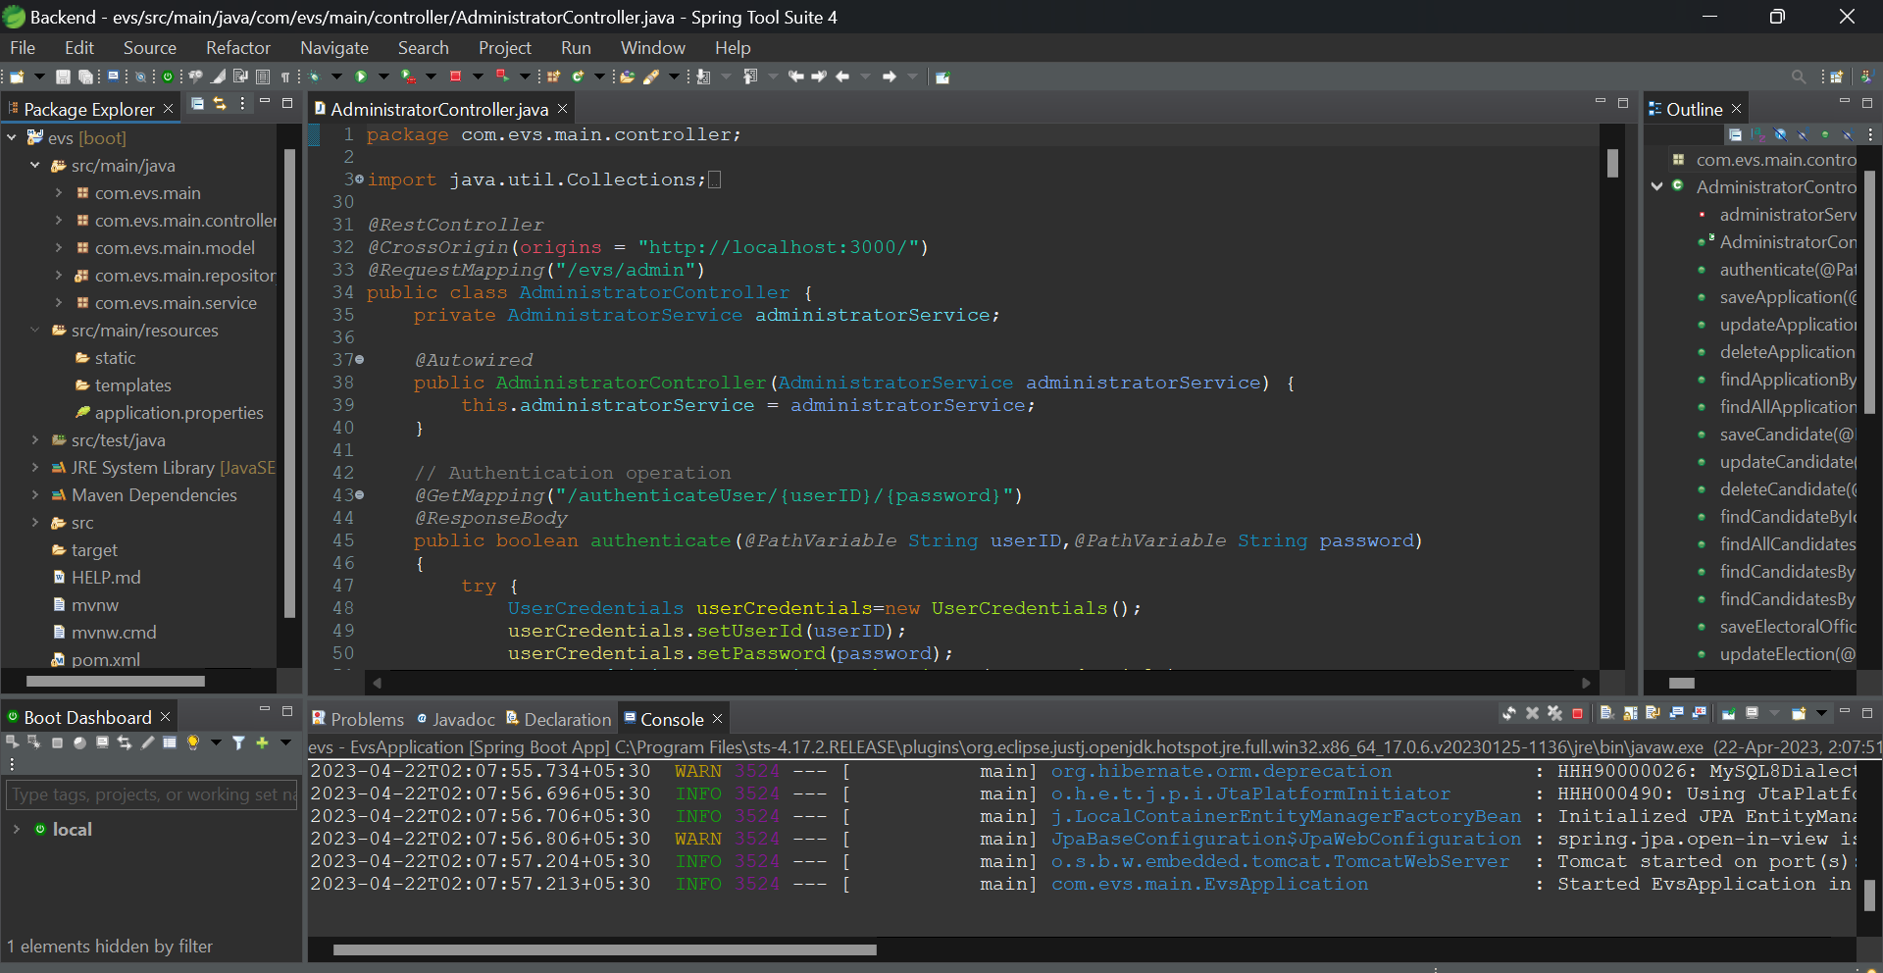
Back-end Development
The back-end development of the election management software will be done using the Spring Tool Suite, with a Spring starter project that includes MySQL table creation and JDBC connectivity. The Hibernate framework will be used to map the database tables to Java objects and HQL will be used to write queries.
This approach will ensure that the back-end is robust, scalable, and easily maintainable, allowing for the efficient storage and retrieval of election data.

Slide 8
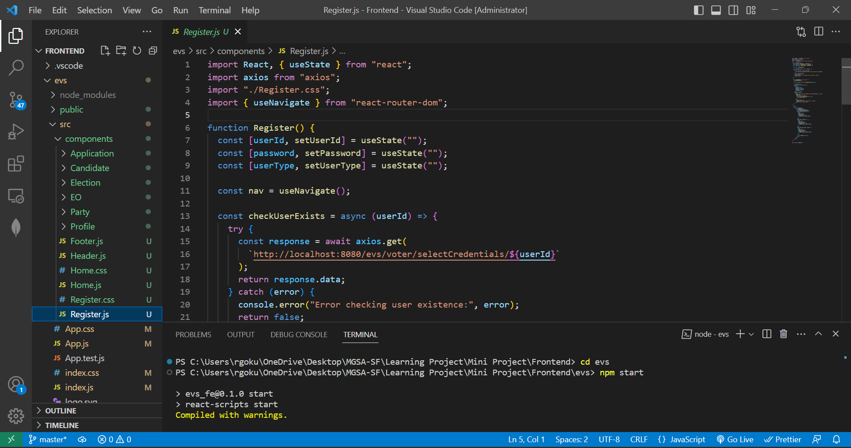
Front-end Development
The front-end development of the election management software will be done using VS Code, with React.js as the primary framework. React-Router-DOM will be used for routing and Axios will be used for handling API requests. This approach will ensure that the front-end is dynamic, interactive, and responsive, providing an intuitive and seamless user experience. The use of modern front-end development tools and technologies will enable the creation of a user interface that is easy to navigate and visually appealing, while also being highly functional and efficient.

Slide 9
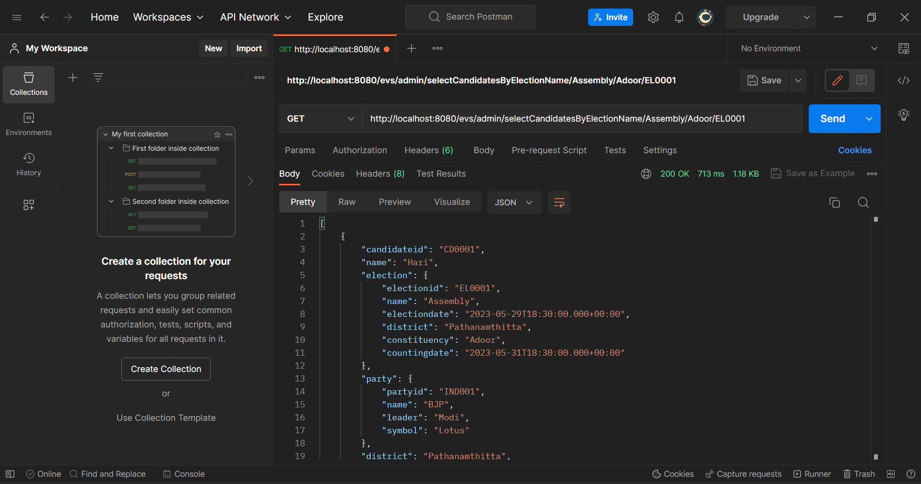
Integration and Testing
Integration and testing of the election management software involved the use of both automated and manual testing methodologies.
Postman was used to test the API endpoints, while manual testing was used to test the user interface and ensure that all features were working as intended.
The use of these testing methodologies helped to identify and resolve any bugs or issues in the software, ensuring that the final product was robust, reliable, and user-friendly.

Slide 10
Deployment
Deployment of the election management software is ongoing with the necessary know-how available to ensure a smooth and efficient deployment process. The deployment process will involve the use of several tools and technologies, including GitHub for version control, Docker and Kubernetes for containerization and orchestration, Helm for deployment management, Jenkins for continuous integration and delivery, AWS EC2 and S3 for cloud hosting, Kafka for messaging, Grafana for monitoring, SonarQube for code quality analysis, and load balancing for scalability and reliability.
In addition, the deployment process will be designed to minimize downtime and ensure high availability, with failover mechanisms and load balancing to ensure that the software is accessible to users at all times. Regular backups and disaster recovery procedures will also be put in place to ensure that data is not lost in case of any unforeseen circumstances. With these measures in place, the election management software will be ready for deployment with a high degree of confidence in its reliability and availability.

Slide 11
Conclusion
In conclusion, the development of the election management software was a complex and challenging project that required a significant amount of planning, design, and implementation. The project involved the use of modern software development methodologies, tools, and technologies to ensure that the software was robust, scalable, and user-friendly. The software was designed to assist election officials in managing the various aspects of the electoral process, including voter registration, ballot creation, vote counting, and reporting of election results.
Throughout the project, a focus was placed on quality, efficiency, and reliability. The software was tested extensively using both automated and manual testing methodologies to ensure that it was free of bugs and issues. The deployment process was also carefully planned and executed to ensure that the software was deployed successfully and was fully operational for use. The end result was a fully functional and reliable election management software that can be used to manage and oversee elections with ease. The project serves as a testament to the importance of modern software development methodologies, tools, and technologies in creating software that meets the needs of users and the demands of the modern world.

Slide 12
Future Work
There is always room for improvement in any software development project, and the election management software is no exception. In the future, several areas of the software could be enhanced to further improve its functionality and efficiency. For example, the software could be expanded to include additional features such as digital signature verification, real-time voter verification, and predictive analytics to help forecast voter turnout. The user interface could also be enhanced to make it more user-friendly and visually appealing.
Another area for future work is the optimization of the software's performance. The use of more efficient algorithms and data structures could help to speed up the processing of data, while the use of cloud technologies could help to improve scalability and reduce operational costs. In addition, the software could be integrated with other election-related systems to provide a more comprehensive solution for election management. Overall, the future work on the election management software would focus on making it more comprehensive, efficient, and user-friendly to meet the evolving needs of election officials and ensure the integrity of the electoral process.

Slide 13
References
References:
Spring Framework - https://spring.io/
React.js - https://reactjs.org/
GitHub - https://github.com/
Docker - https://www.docker.com/
Kubernetes - https://kubernetes.io/
Jenkins - https://www.jenkins.io/
AWS EC2 - https://aws.amazon.com/ec2/
Kafka - https://kafka.apache.org/
Grafana - https://grafana.com/
Load Balancing - https://www.nginx.com/resources/glossary/load-balancing/
Stack Overflow - https://stackoverflow.com/
ChatGPT - https://github.com/chatgpt/

Slide 14
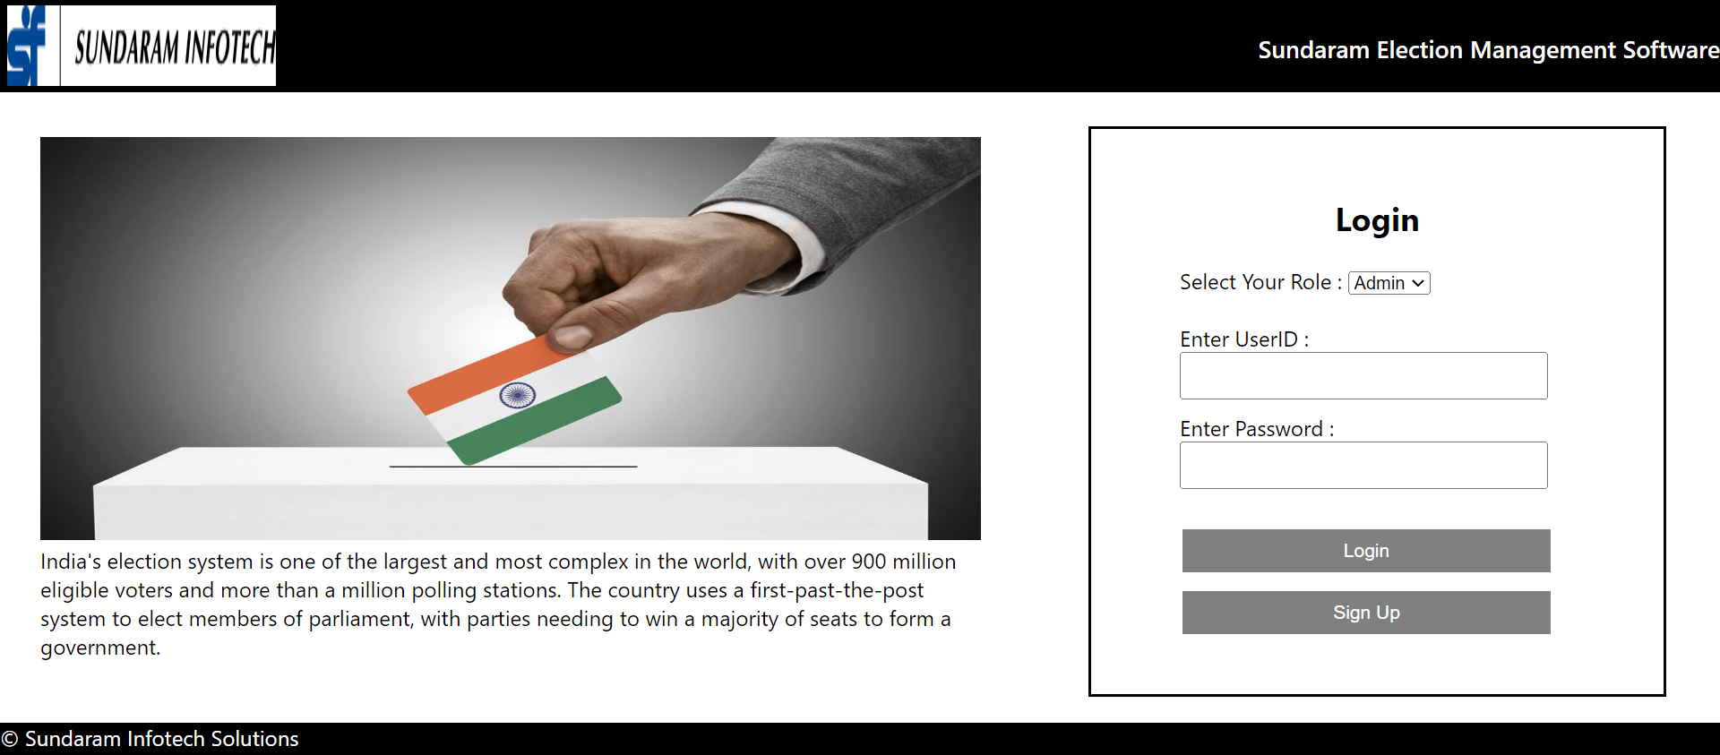
Appendices

Slide 15
Appendices

Slide 16
Appendices

Slide 17
Appendices

